Slide 1
Prompt example
참고 링크 : https://civitai.com/

Slide 2
Model link(example)
https://civitai.com/models/926845/rdxl-sfw

Slide 3
Source code link
https://colab.research.google.com/drive/1Y1X42wIgqIXsAvVMKb88-XugehJHcRSr?usp=sharing

Slide 4
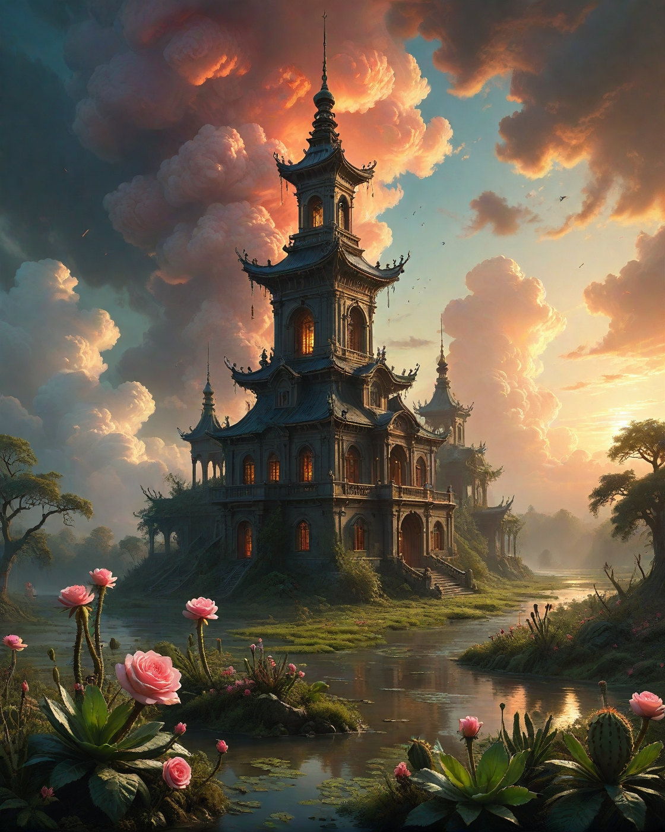
Example
prompt
Floodplain meadow with winding oxbow lake, fern fiddleheads uncurling,Titanium pagoda healing with self-repair rituals, Cumulonimbus sunset: Anvil tops blooming into radioactive rose formations, rains that colorize monochrome landscapes, years lasting minutes with hyper-evolution,Neural network dusk training AI hallucinations, Mutations of cacti growing gemstone spines, artstation, trending on artstation, highly detailed fantasy art, stocking, intricate, elegant, highly detailed, centered, digital painting, concept art, smooth, sharp focus,random rider in landcscape,<lora:tbh124-sdxl:0.15> style of Jean-Antoine Watteau,<lora:tbh112-sdxl:0.15> style of Gregory Fromenteau, <lora:add-detail-xl:0.7> <lora:Flux-XL_Scenery:0.15> flux-scenery, <lora:Flux-style-xl-lora:0.15> flux-style <lora:1dkXLP:0.15> 1dk,<lora:extremely_detailed:0.7> extremely detailed,, Baroque art style, dynamic composition, dramatic lighting, rich colors, intricate details, professional-grade execution, captures the grandeur and theatricality of the Baroque period
Negative prompt
EasyNegativeV2, bad-picture-chill-75v,, signature, watermark, ugly, off-center, deformed, cropped, frame, worst quality, low quality, lowres, JPEG artifacts
Model : Book Illustration Char

Slide 5
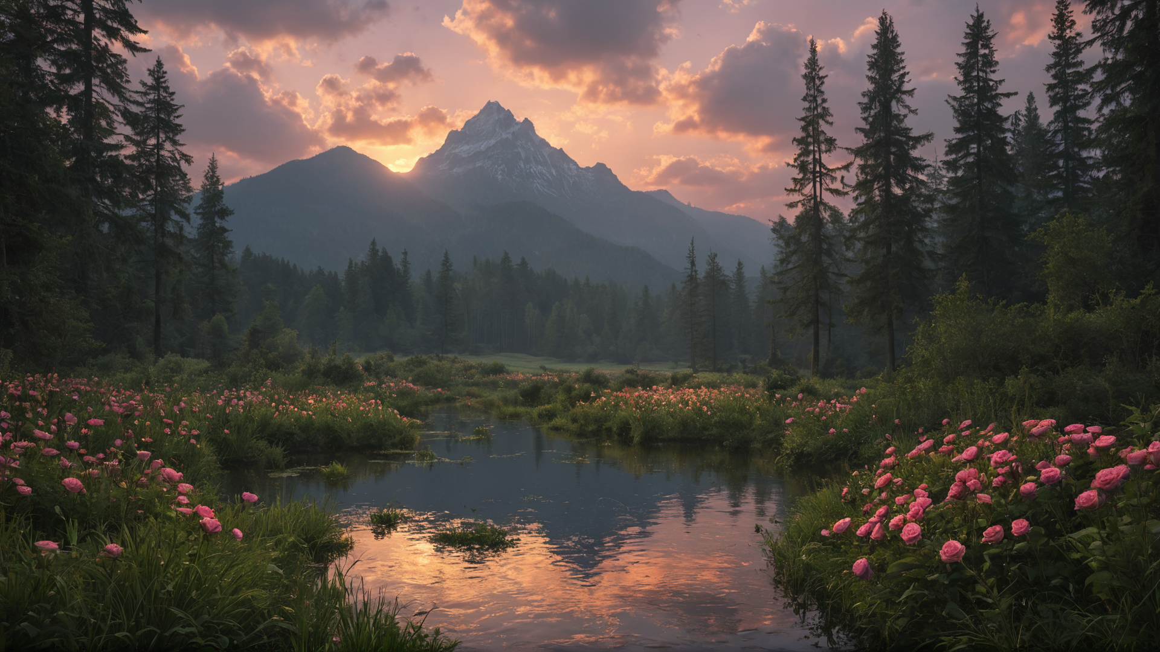
Try this

Slide 6
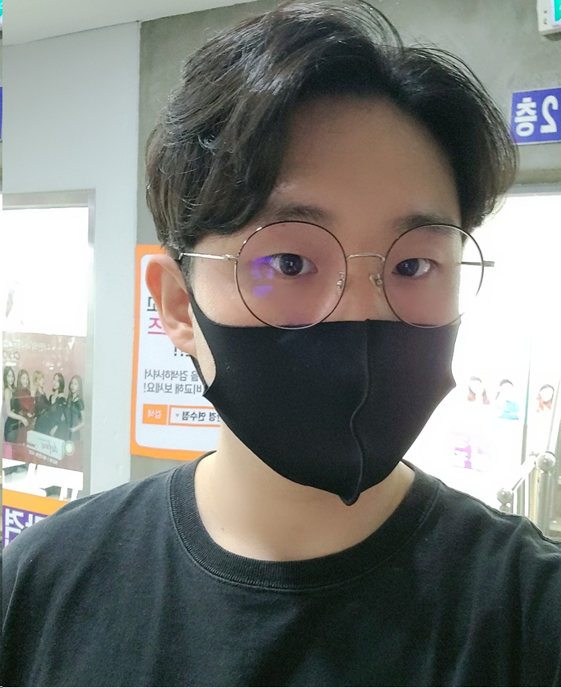
Example Image to Image
prompt
A handsome man in his 30s, with short black hair and a confident smile, wearing a dark leather jacket and blue jeans. He is standing in a modern urban environment, with a sunset background and soft lighting highlighting his features. The image should have a cinematic feel with high-quality details and realistic lighting
Negative prompt
No blurry images, no cartoonish features, no exaggerated facial expressions, no distortion, no low-resolution, no strange anatomy, no cluttered background, no unnatural lighting, no poor quality textures, no overly saturated colors.

Slide 7
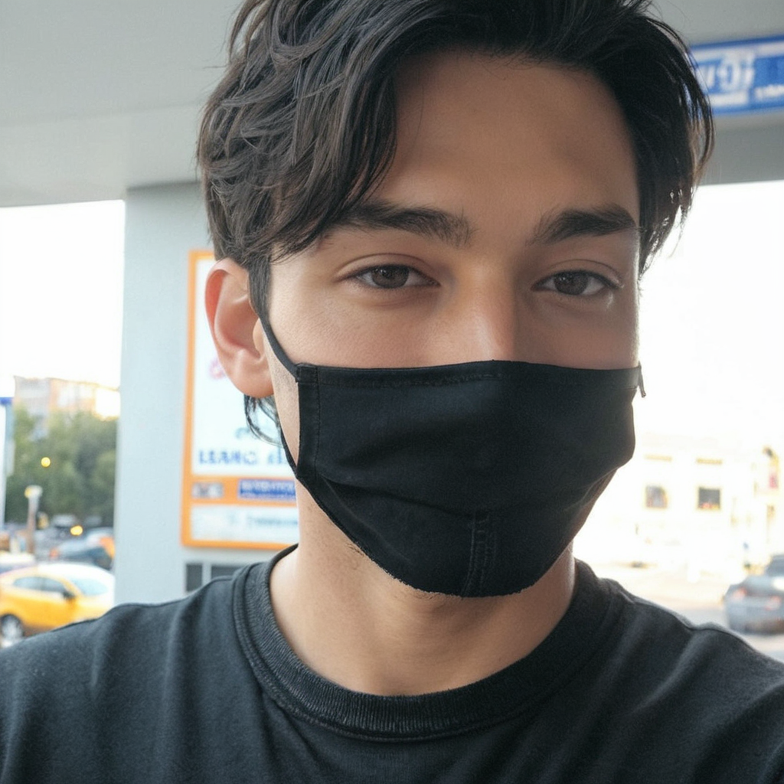
Try this

Slide 8
